Slide 1



IPW Simulation
Department of Biostatistics and Bioinformatics,
Duke University
November 11, 2017

Slide 2
Overview
Data Generation Methods
Missingness Generation Methods
Missingness Handling Methods
CRA
IPW
MMI
Results

Slide 3

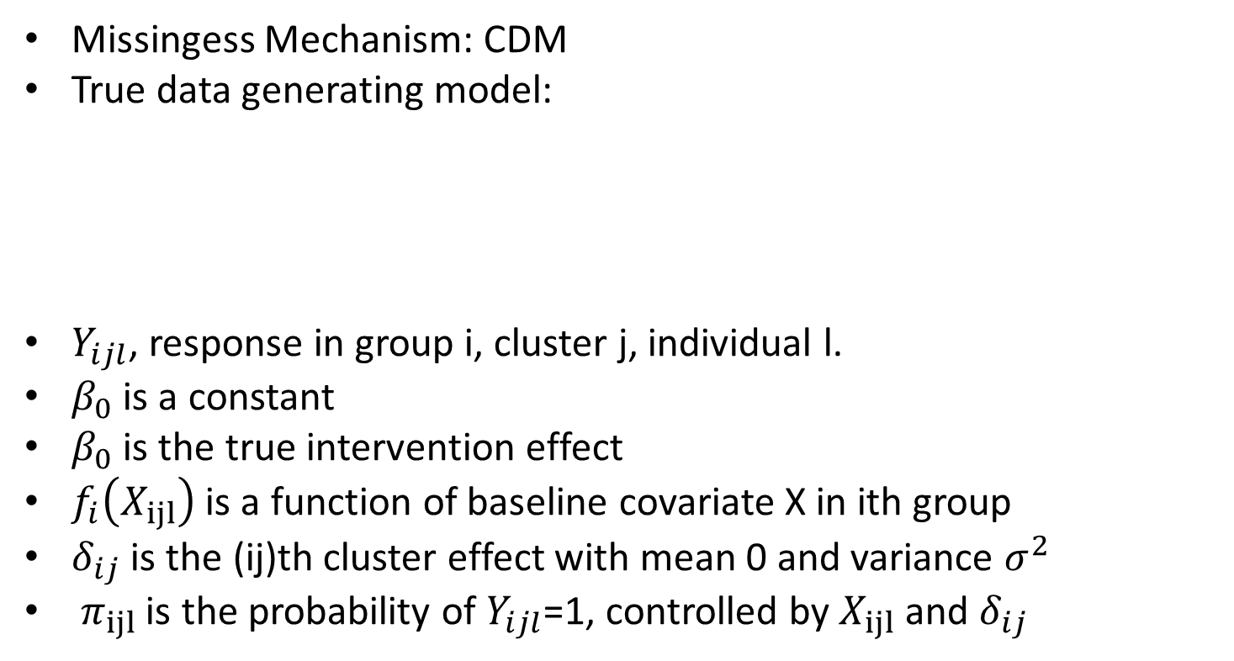

Data Generation
Missingess Mechanism: CDM
True data generating model:
$Y_{ijl}$, response in group i, cluster j, individual l.
$β_{0}$ is a constant
$β_{0}$ is the true intervention effect
$f_{i}\left(X_{ijl}\right)$ is a function of baseline covariate X in ith group
$δ_{ij}$ is the (ij)th cluster effect with mean 0 and variance $σ_{}^{2}$
$π_{ijl}$ is the probability of $Y_{ijl}$=1, controlled by $X_{ijl}$ and $δ_{ij}$
$$π_{ijl}=exp(β_{0}+β_{1}i+f_{i}\left(X_{ijl}\right)+δ_{ij})$$
$$Y_{ijl} ∼Bin(1,π_{ijl})$$

Slide 4

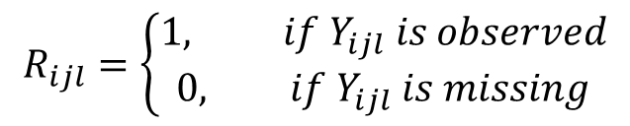


Missingness Generation
Missingess indicator $R_{ijl}$:
Missing generation function:
Covariate generation:
$$R_{ijl}=\left\{\begin{aligned}1, if Y_{ijl} is observed \\ 0, if Y_{ijl} is missing\end{aligned}\right.$$
${logit(R}_{ijl}=0|Y_{ijl, }X_{ijl}$)=$ψ_{i}+φ_{i}X_{ijl}$
$$X_{ijl}=α_{ijl}+u_{ijl}$$

Slide 5
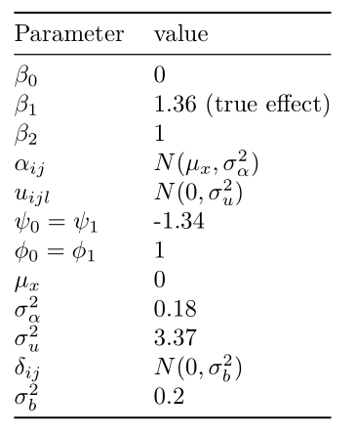




Covariates values
$$π_{ijl}=exp(β_{0}+β_{1}i+f_{i}\left(X_{ijl}\right)+δ_{ij})$$
${logit(R}_{ijl}=0|Y_{ijl, }X_{ijl}$)=$ψ_{i}+φ_{i}X_{ijl}$
$$X_{ijl}=α_{ijl}+u_{ijl}$$
$$Y_{ijl} ∼Bin(1,π_{ijl})$$

Slide 6
Covariates values
For data generation:
Generalized linear mixed model
In analysis part:
GEE
Therefore, the data generation process gives us a conditional estimate while data analysis model provides us a marginal estimate.
True value of population averaged log(OR) for GEE by empirically estimation using full data.
K=25, 50
M=25, 50

Slide 7
Missingness Handling Methods
Complete Record Analysis
Unadjusted
Adjusted
Inverse Probability Weighting (IPW):
Multilevel Multiple Imputation

Slide 8


Missingness Handling Methods
Complete Record Analysis
Unadjusted
Adjusted
$$\operatorname{logit}\left(π_{ijl}\right)=β_{0}^{∗}+β_{1}^{∗}\text{grou}p$$
$\operatorname{logit}\left(π_{ijl}\right)=β_{0}^{∗}+β_{1}^{∗}\text{grou}p$+$β_{2}^{∗}X_{ijl}$

Slide 9
Missingness Handling Methods
Inverse Probability Weighting (IPW):
Without cluster effects:
Logistic Regression:
With cluster effects
Logistic Regression
$$\operatorname{logit}\left(P(Y_{ijl}=1)\right)=β_{0}^{∗}+β_{1}^{∗}X_{ijl}$$
$f\left(X_{ijl}\right)=P\left(Y_{ijl}=1|X_{ijl}\right)=expit(β_{0}^{∗}+β_{1}^{∗}X_{ijl}$)
Weight for $X_{ijl}=1/f\left(X_{ijl}\right)$
$\operatorname{logit}\left(P(Y_{ijl}=1)\right)=β_{0}^{∗}+β_{1}^{∗}X_{ijl}$+$δ_{ij}$
$f\left(X_{ijl}\right)=P\left(Y_{ijl}=1|X_{ijl},δ_{ij}\right)=expit(β_{0}^{∗}+β_{1}^{∗}X_{ijl}+δ_{ij}$)
Weight for $X_{ijl}=1/f\left(X_{ijl}\right)$

Slide 10


Missingness Handling Methods
Inverse Probability Weighting (IPW):
Analysis Model : GEE
In R: glm or glmr + geese with weight
GEE estimator
GEE estimator with weights:

Slide 11
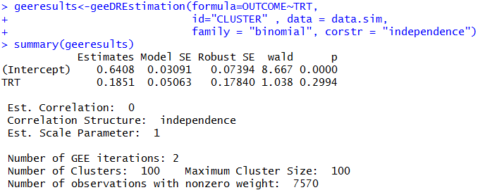

Missingness Handling Methods
Inverse Probability Weighting (IPW):
Package: ‘CRTgeeDR’

Slide 12
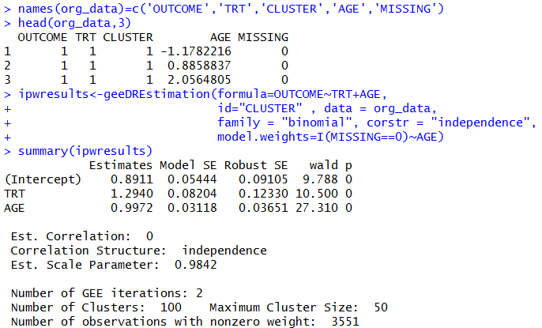
Missingness Handling Methods
Inverse Probability Weighting (IPW):

Slide 13
Missingness Handling Methods
Multilevel Multiple Imputation：
Requires 3 steps:
Imputation: Impute (=fill in) the missing entries of the incomplete data sets, m times (5 times here). Imputed values are drawn for a distribution. This step results is m complete data sets.
Analysis: Analyze each of the m completed data sets. This step results in m analyses.
Pooling: Integrate the m analysis results into a final result. Such as Rubin’s Rules.

Slide 14
Missingness Handling Methods
Multilevel Multiple Imputation：
Imputation Model :
With a random cluster effect
Analysis Model (GEE):
$\operatorname{logit}\left(π_{ijl}\right)=β_{0}^{∗}+β_{1}^{∗}\text{grou}p$+$δ_{ij}^{∗}$
$\operatorname{logit}\left(π_{ijl}\right)=β_{0}^{∗}+β_{1}^{∗}\text{grou}p$+$β_{2}^{∗}X_{ijl}$

Slide 15
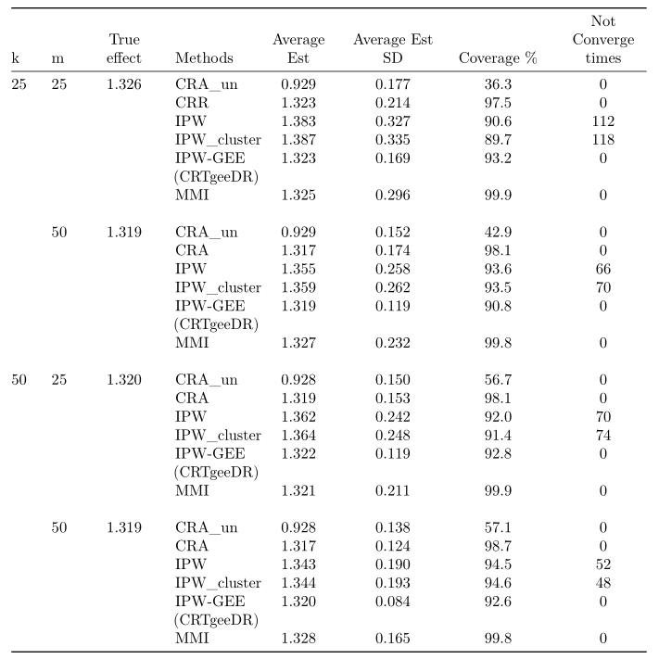
Notes:
Mmi no biase increasing variance

Slide 16
Thank You!

